Slide 1
0x204 – Authentication
ECED4406 – Computer Security
Dr. Colin O’Flynn
Dalhousie University.

Slide 2
Non-Repudiation
Non-repudiation actually combines two things:
Integrity of a transaction (i.e., email, bank transfer, etc).
Authentication of the user performing the transaction.
Authentication is itself an important discussion.

Slide 3
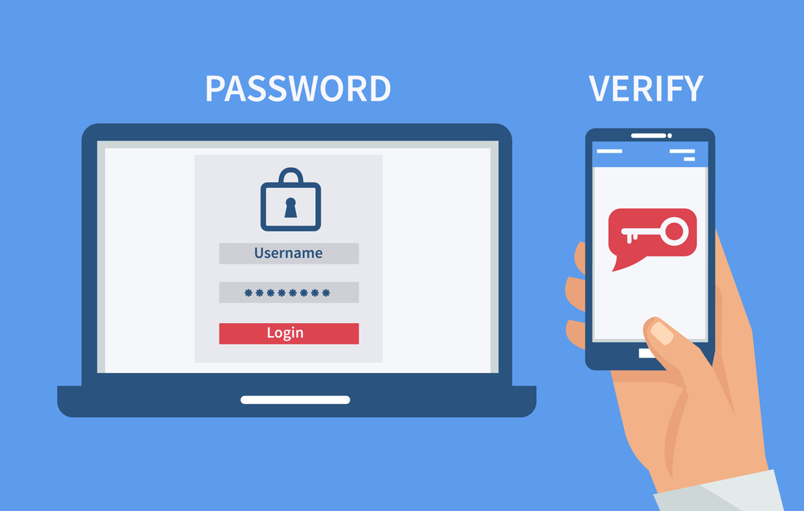
Authentication? Two-Factor Authentication?

Slide 4
Cryptographic Authentication
In cryptographic authentication, we will normally force knowledge of a secret key.
There are several ways to force such knowledge.

Slide 5
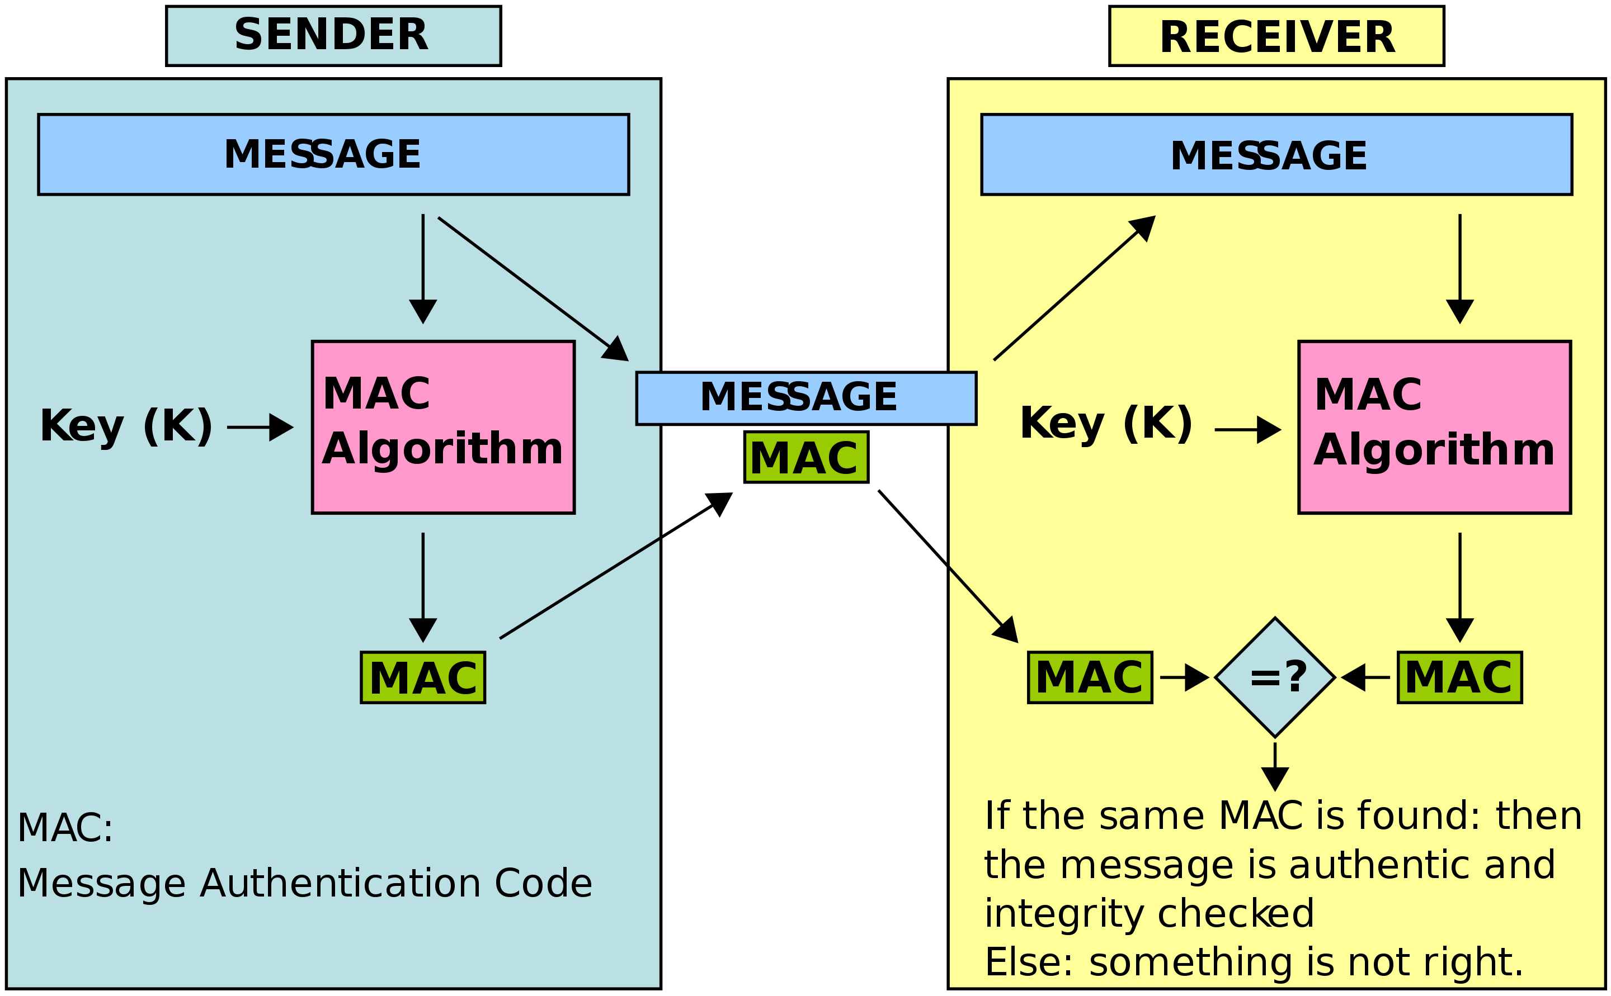
Message Authentication Code
https://en.wikipedia.org/wiki/Message_authentication_code#/media/File:MAC.svg

Slide 6
Public / Private Key Pairs
We’ll discuss some of these algorithms later, but for now:
Public key cryptography allows us to design algorithms with two keys:
One key is “private” and performs one operation (such as decryption).
The other key is “public” and performs another operation (such as encryption).
Knowing only the “public” key you cannot perform both operations.

Slide 7
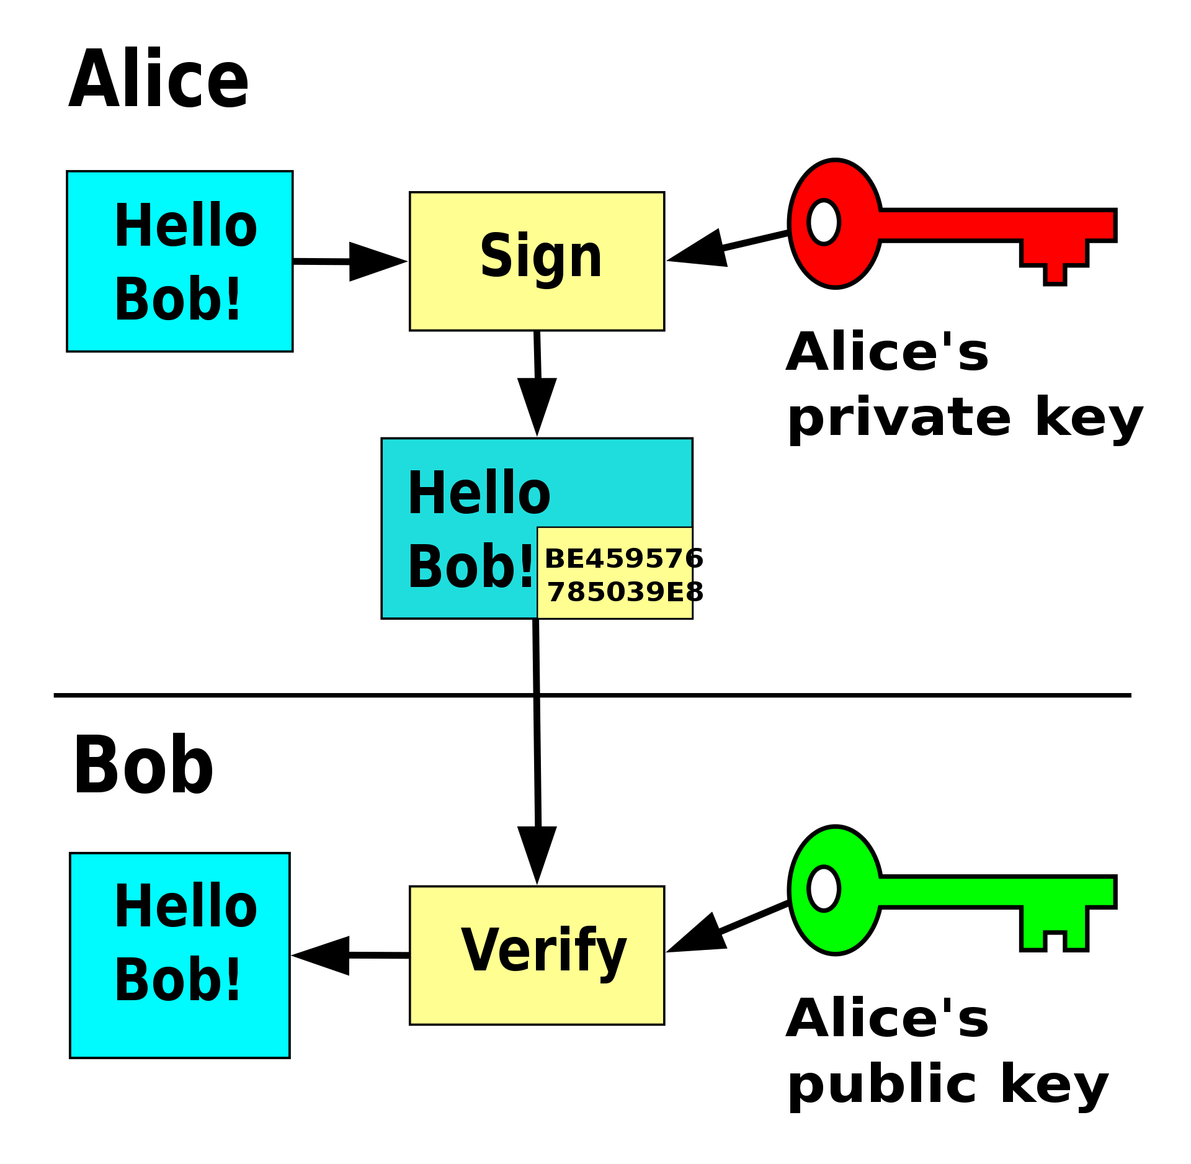
Public/Private Key Signing
https://en.wikipedia.org/wiki/Public-key_cryptography#/media/File:Private_key_signing.svg

Slide 8
Authentication of Files
Authentication will become critical for operations such as secure boot.
To authenticate a file, we calculate the hash of a file, and we sign the hash of that file with a private key.
An associated public key must be trusted by the end user.
For example – manufacture could program their public key into the device. In the future they can be assumed that only files signed with their private key will be booted.

Slide 9
Authentication Summary
Authentication is a critical aspect of cryptographic solutions.
Combining authentication with integrity & confidentially provides us with a way of securely transmitting data, while trusting the source of the data, and that is has not been modified.

